Slide 1
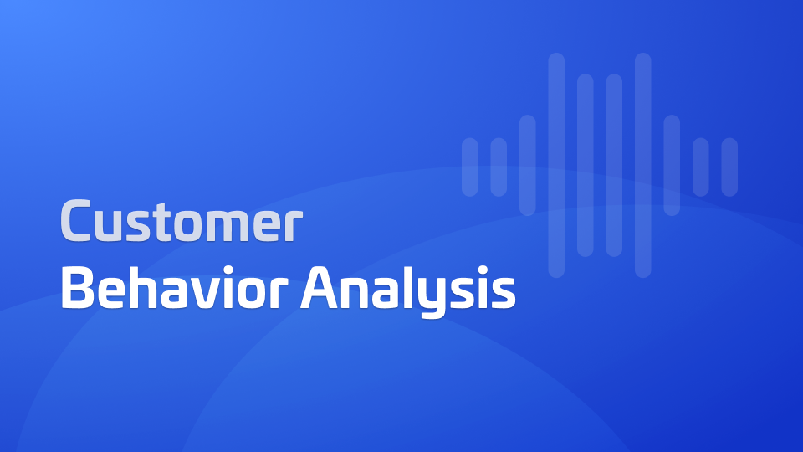

3,900
Customer Shopping
Behavior Analysis
Purchases Analyzed
18
Data Features
Uncovering Insights from Transactional Data
Python , SQL , PowerBi
Analysis Tools

Slide 2




Project Overview
Analysis of customer shopping behavior using transactional data to guide strategic business decisions.
3,900
Spending Patterns - Analyze purchase amounts and frequency
Purchases Analyzed
Customer Segments - Identify distinct shopping behaviors
18
Product Preferences - Discover popular items and categories
Data Features
Subscription Behavior - Evaluate subscription impact
Various
Product Categories

Slide 3





Dataset Summary
Key Features
Customer Demographics
Purchase Details
3,900
Age
Item Purchased
Gender
Category
Rows
Location
Purchase Amount
Subscription Status
Season, Size, Color
18
Columns
Shopping Behavior
Additional Features
Discount Applied
Review Rating
37 missing values in Review Rating column
Promo Code Used
Shipping Type
Previous Purchases
Frequency of Purchases

Slide 4











Exploratory Data Analysis using Python
Data Preparation
Feature Engineering
Data Loading
Initial Exploration
Created age_group column by binning customer ages
Imported dataset using pandas
Used df.info() and .describe()
Missing Data Handling
Column Standardization
Created purchase_frequency_days column from purchase data
Imputed missing values in Review Rating column
Renamed columns to snake case
Data Consistency Check
Database Integration
Redundancy Analysis
1 Connected Python script to PostgreSQL database
Verified if discount_applied and promo_code_used were redundant
2 Loaded cleaned DataFrame into database
Dropped promo_code_used column to eliminate redundancy
3 Prepared data for SQL analysis and business insights

Slide 5










Data Analysis using SQL
Key Business Questions Analyzed in PostgreSQL
Revenue by Gender
High-Spending Discount Users
Compared total revenue generated by male vs. female customers
Identified customers who used discounts but still spent above average
Top 5 Products by Rating
Shipping Type Comparison
Found products with the highest average review ratings
Compared average purchase amounts between Standard and Express shipping
Subscribers vs. Non-Subscribers
Discount-Dependent Products
Compared average spend and total revenue across subscription status
Identified 5 products with the highest percentage of discounted purchases
Customer Segmentation
Top 3 Products per Category
Classified customers into New, Returning, and Loyal segments
Listed the most purchased products within each category
Repeat Buyers & Subscriptions
Revenue by Age Group
Checked if customers with >5 purchases are more likely to subscribe
Calculated total revenue contribution of each age group

Slide 6












Dashboard in Power BI
Customer Shopping Analytics
Built an interactive dashboard in Power BI to present insights visually from the customer shopping behavior analysis.
Key Visualizations
Revenue by demographic segments
Purchase patterns by season
Revenue by Gender
Top Products by Category
Comparative analysis of spending patterns
Best-selling items per segment
Product performance metrics
Customer segments analysis
Interactive Features
Dynamic filtering by multiple criteria
Time-based analysis controls
Customer Segments
Purchase Frequency
New, Returning, and Loyal customers
Time-based shopping patterns
Interactive dashboard enables stakeholders to explore data independently and make data-driven decisions

Slide 7





Business Recommendations
Boost Subscriptions
Customer Loyalty Programs
Promote exclusive benefits for subscribers to increase conversion rates
Reward repeat buyers to move them into the "Loyal" segment
Review Discount Policy
Product Positioning
Balance sales boosts with margin control to optimize profitability
Highlight top-rated and best-selling products in campaigns
Targeted Marketing
Focus efforts on high-revenue age groups and express-shipping users
These strategic actions are based on data-driven insights from the customer shopping behavior analysis

Slide 8


Thank You
Charka Mahesh

